Slide 1
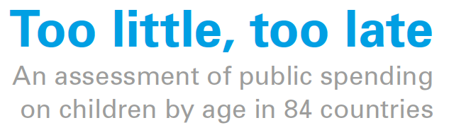
EGM Mexico, January 2024
Dominic Richardson (The Learning for Well-being Institute)
David Harris (Columbia University, US and UNICEF Innocenti)

Slide 2
Key Messages
There is no consensus on how to manage a portfolio of child and family policies worldwide; best evidence is not followed; data on how and when expenditure happens is incomplete
Available data shows chronic underinvestment in children, particularly in the early year, and a relative underinvestment in both cash and care services in non-OECD countries
In the poorest countries, children that miss out on school receive less 3 thousand USD PPP per head throughout childhood – and under 6’s receive less than 7 per cent of total
OECD countries spending shows a slight trend increase in family policy spending overall, with larger relative increases in early years spending and childcare specifically
The poly-crisis risks both domestic spending and foreign assistance

Slide 3
Understanding the when & how of investment in children
Consensus on importance of early childhood dev. across sectors
Critical for inclusive development
  Within and between country inequalities
Demand for greater effectiveness and efficiency
Achievement of the SDGs
Notes:
UNICEF’s PF4C right-based approach aims to accelerate investments for children

Slide 4





Age-related development of elementary skills
Listening, Empathising, Inquiring
Discerning patterns, Embodying, Observing, Reflecting, Relaxing, Sensing
Fluency in: ideation, divergent thinking, self-regulation (ado), affective empathy, intuition
Source: Richardson et al, 2021

Slide 5
Understanding the when & how of investment in children
Consensus on importance of early childhood dev. across sectors
Critical for inclusive development
  Within and between country inequalities
Demand for greater effectiveness and efficiency
Achievement of the SDGs
Notes:
Key messages:
UNICEF's work in public finance is pivotal to scaling up equitable and inclusive social services
UNICEF’s unique role as a convener at country level has enabled strengthening of budgets and leveraging of resources for children, and accelerating investments in children and human capital
UNICEF adopts a right-based approach to financing to ensure universal and equitable access to social services and leaving no one behind. To ensure realizing a universal agenda, we focus on equity, participation and reaching all children, including those most vulnerable and marginalized.
UNICEF undertakes evidence generation, advocacy, and policy dialogue to make children a priority in public budgets. UNICEF translates evidence-based advocacy and policy dialogue into programmatic interventions that have positive impacts on social sectors financing.
UNICEF applies a system strengthening approach at both central and subnational levels of government, with a focus on public finance management reforms, performance-based budgeting, and subnational financial flows.
UNICEF works with government and partners to actively engage in all stages of the budget process - strategic planning, budget preparation, implementation, and reporting - to build an evidence-based case to improve social services for children.
UNICEF has been instrumental in safeguarding social spending and in supporting the expansion of fiscal space. This includes mobilizing domestic resources as well as leveraging international resources through mechanisms such as scaled up Official Development Assistance, debt relief, bonds, and concessional lending.
UNICEF leverages its expertise on public finance in all different contexts including humanitarian and fragile contexts, while ensuring transparency, systems strengthening and promoting the nexus between development and humanitarian action.
UNICEF works in partnership to enhance investments in in children and human capital
UNICEF has strong field presence and long-standing public finance work at country level, for over 10 years
Public finance capacity strengthening of UNICEF’s technical staff as well as senior leaders as an organisational priority
UNICEF’s public finance work is guided by a clear vision on how to achieve results for children and is supported by technical guidance to UNICEF staff on public finance programming approaches with UNICEF’s Global Public Finance for Children framework, and an action-oriented public finance toolkit
UNICEF’s global evidence and advocacy on safeguarding social spending and advancing investments in human capital has influenced decision and policy makers and has been cited in key global financing documents.

Slide 6
Key expenditure figures
Low-income countries spend just USD 11 thousand PPP per child if they attend preschool and complete compulsory school, and just 2.3 thousand per child capita overall. Just 6.7 percent of this is reserved for the under sixes.
Low-middle income countries are spending USD 18 thousand per child if they attend preschool and complete compulsory school, and 13.6 thousand per child capita overall. Just 8.2 percent of this is reserved for the under sixes.
Upper-middle income countries are spending USD 43 thousand per child when attending both school and pre-school, and 35.3 thousand per child overall. Just 11.5 percent of this is reserved for the under sixes.
High-income countries are spending USD 195 thousand per child when attending both school and pre-school. And 27 percent of this is reserved for the under sixes.

Slide 7
Comparing age-related expenditure profiles
ASPIRE expenditures
SSPTW
Manchester University, Social Assistance Explorer
UIS education statistics (expenditures and enrolment)
OECD sources
UN Population data
World Bank DataBank
  GDP, NCUs, and USD/PPPs
Only public spending
Local spending underestimated
Health spending is missing, but marginal
Does not measure service quality
Take-up
Averages hide detail by child need
Relies on a few assumptions
OECD has better data!
Notes:
Majority of HICs are highly decentralized, including Canada, which is one of the most decentralized federations: therefore subnational finance is very important for improving child wellbeing. In the OECD countries , subnational governments - states, regions, municipalities - account for 40% of total public expenditure and 57% of total public investment in their countries.
In Canada subnational government expenditure (SNG) as a percentage of GDP is more than 53% in 2020 (increase form 31% in 2013). SNG investment is particularly large in the federal countries, accounting for 63.1% of public investment (close to 90% in Belgium and Canada), against about 33.9% in the unitary countries.

Slide 8
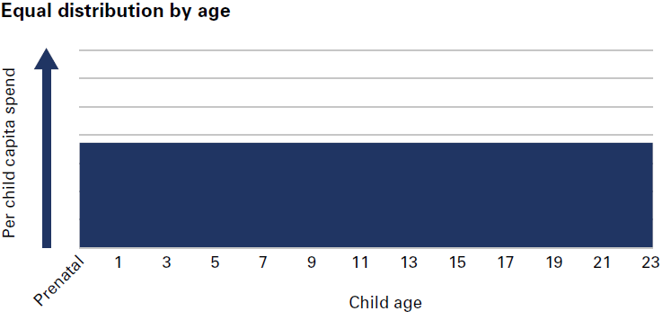
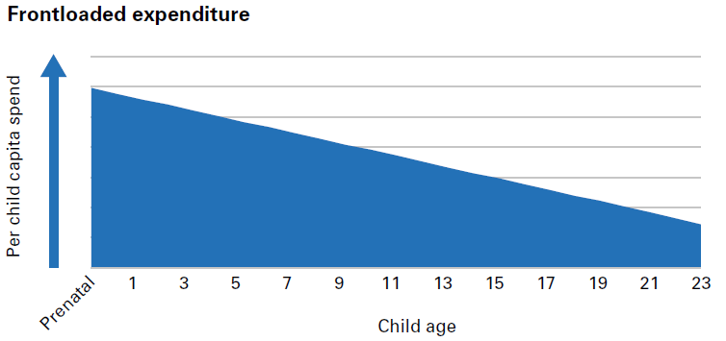
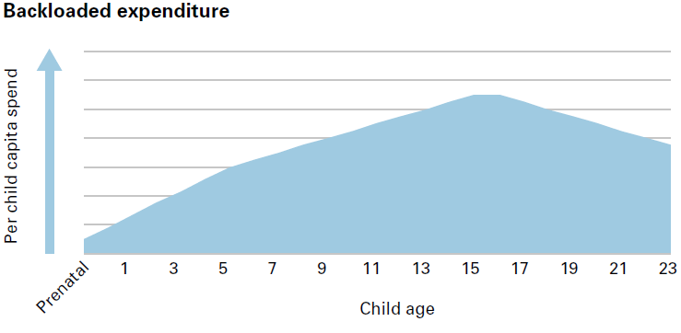
Understanding the Age-Spending Profiles

Slide 9
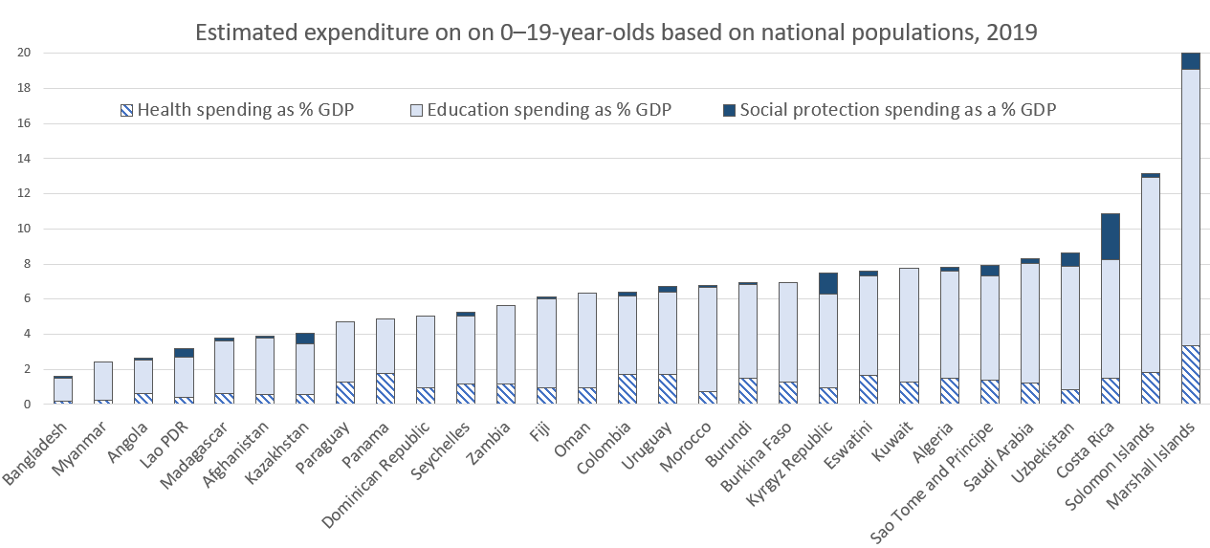
Balance of cross-sectoral spending in LMIC countries

Slide 10
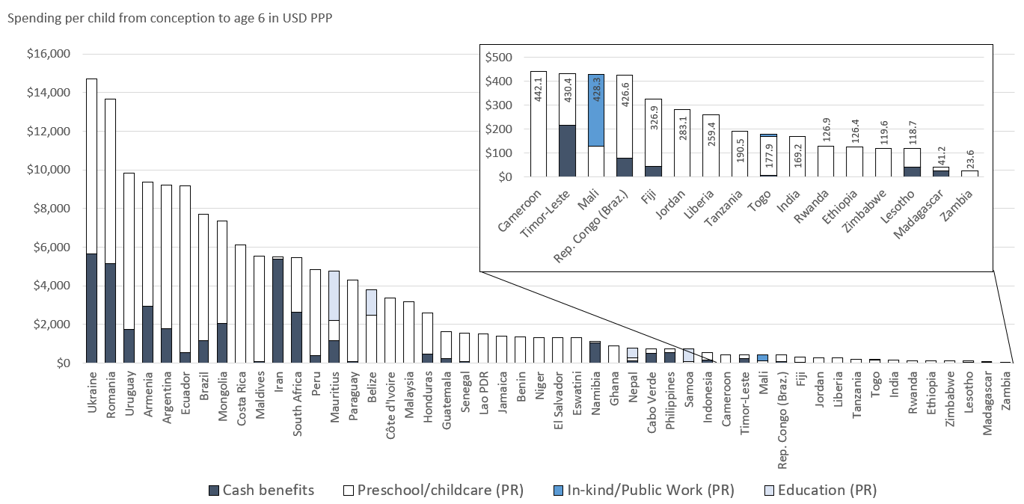
Differences in expenditures on young children in LMIC countries

Slide 11
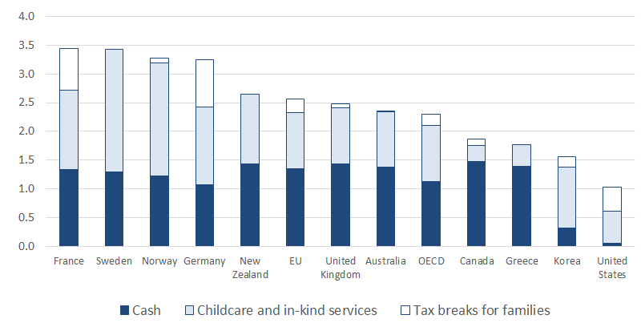
Differences in family policy expenditures in OECD countries
Source: OECD, 2023

Slide 12
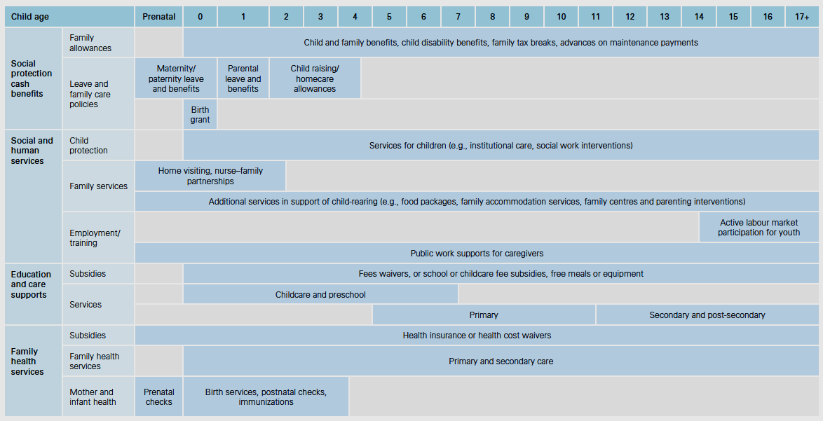

Slide 13
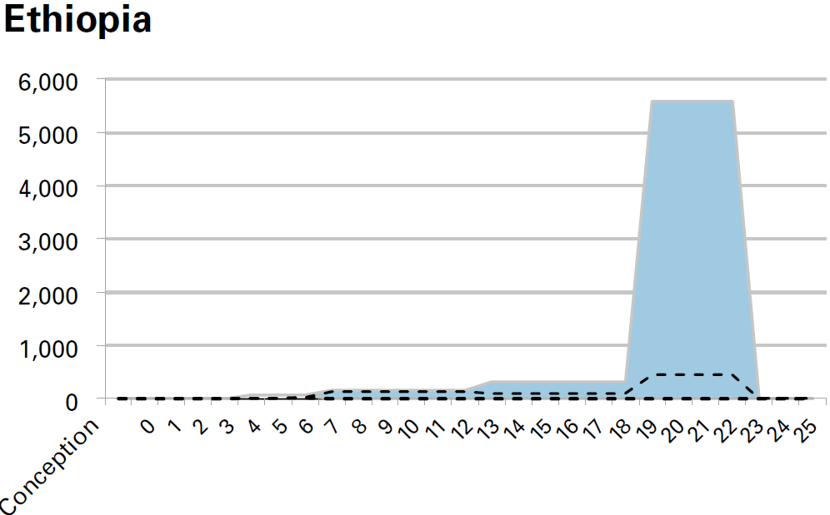
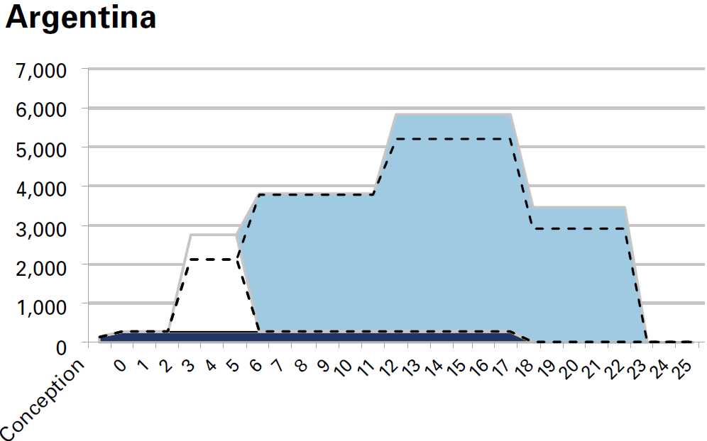
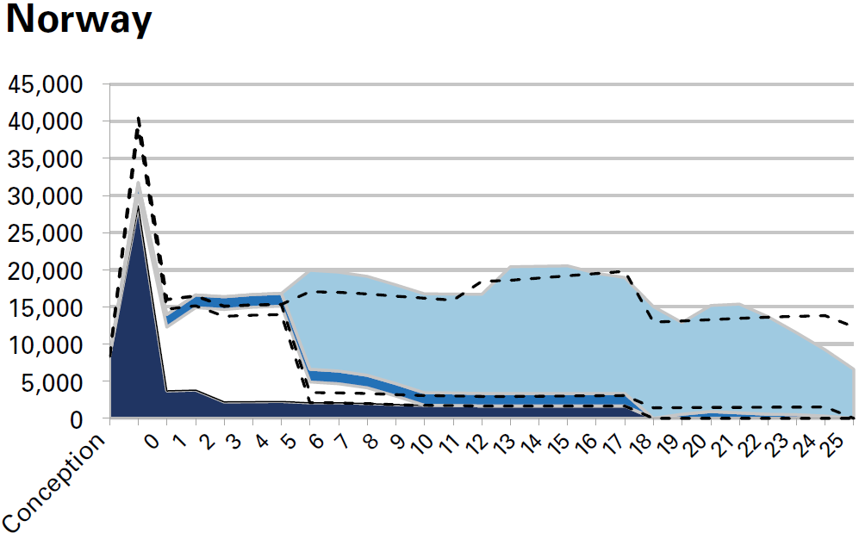
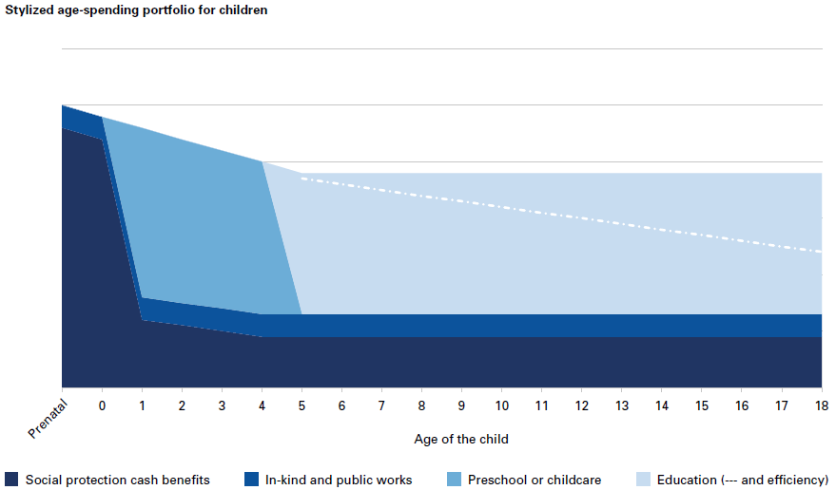
Examples of country profiles
Per capita child spend (USD PPP)
Adapted from: Heckman (2007)
Source: Richardson et al, 2023
Age of the child
Source: Richardson et al, 2023
Notes:
Evidence clear: public spending on children is a smart investment. HOWEVER:
Adequacy: Financing annual shortfalls in low and lower-middle-income countries.
On average, $281 per child (education); $513 per capita (health); and $66 per capita (social assistance, as a component of broader social protection).
Climate impacts not integrated in social secot spending: Financing gap for adaptation measures: US$ 140-300 billion/year by 2030
Equity: Major inequities within countries; e.g.: only 9% of social protection spending is going to the poorest quintile
Efficiency: Limited Absorption capacity, management of resources, planning: Enhancing efficiency can unlock critical resources for national development priorities: e.g.: 2 per cent of GDP spending on education in low- and middle-income countries is lost due to inefficient spending and management.
Prioritization: 1in 8 Low Income Countries spent more on debt service than on education, health and social protection combined

Slide 14
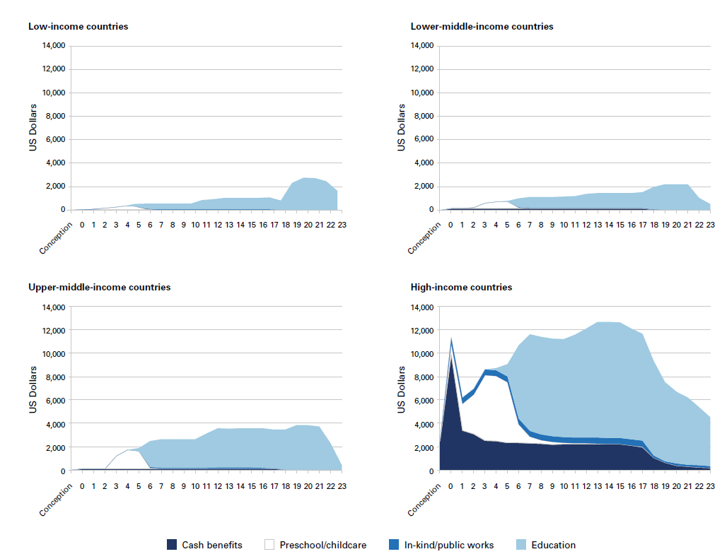
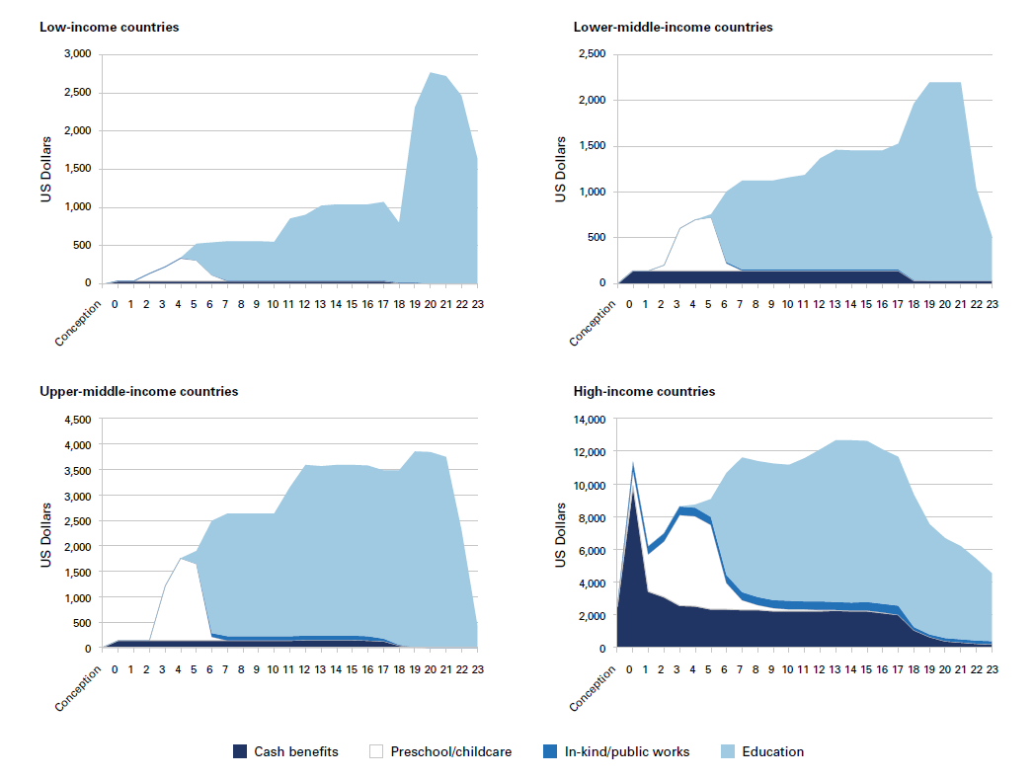
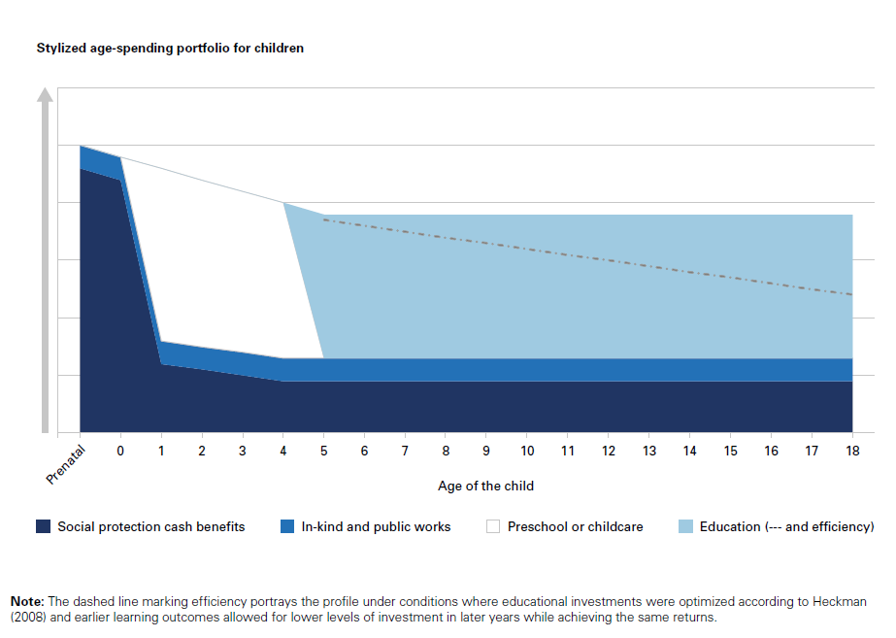
How & when money is spent on children matters!
Notes:
Imbalanced
Incoherent
Unequal

Slide 15
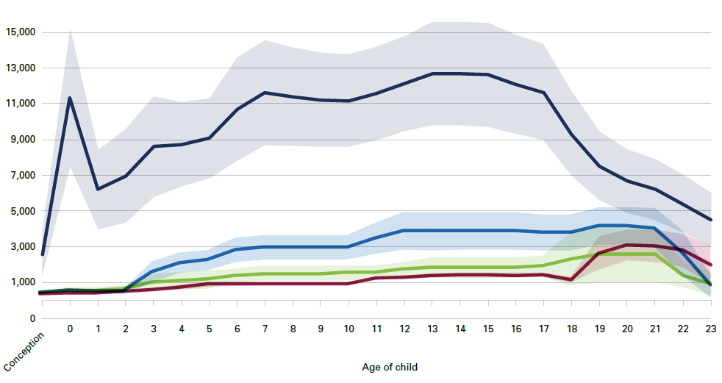
Comparing national income groups differences
Source: Richardson et al, 2023

Slide 16
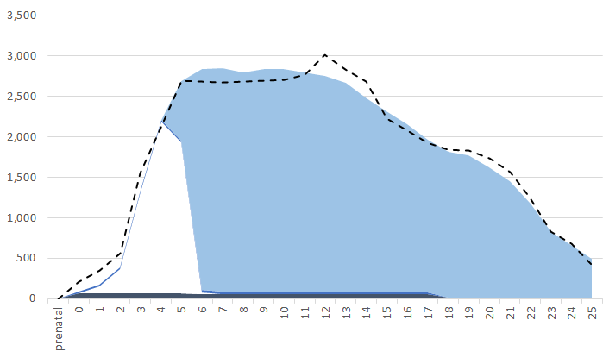
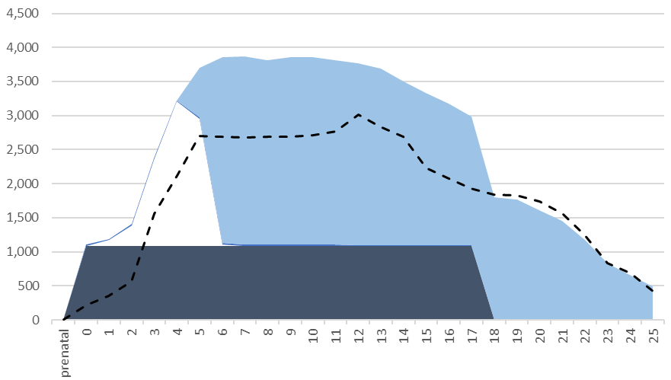
Mexico profile, 2019
Notes:
Mexico eradicates extreme child poverty with UCB at 6% or average wage.
Spending on the youngest goes up from 25 to 29 per cent of total
Spending on cash goes up form 3 per cent to 34 per cent.
Mexico GDP on families goes up from 0.6 per cent to 3.1 per cent. Or the 12 highest spending in OECD countries.
Relative poverty falls from Poverty Rate child pop: 20.02, Poverty Rate without allowance: 20.02, to Poverty Rate UCB: 12.77 (36% reduction), above the OECD average poverty rates equivalent to countries like Switzerland, Portugal, Korea and Slovakia.

Slide 17
Delivering on a Universal Child Benefit
Only one in every four children aged 0–18 years have access to a child or family benefit
Global crises have demonstrated how essential social protection systems are for achieving the rights of children
Significant underinvestment in social protection has contributed to persistent gaps in coverage for children.
Evidence shows UCBs to be a cost-effective way to reduce child poverty in both absolute and relative terms
  Currently, 46 countries and territories operate UCBs or quasi-UCBs.
The details matter. Policy design should be informed by international social security standards
Notes:
Universal Child Benefits (UCBs) are the foundational policy for children and indeed society as a whole. As cash payments made on a regular basis for flexible use to support children’s needs, UCBs offer a simple and scalable route to increase public investment in all children, and especially those in early childhood where welfare systems are weakest, through universal coverage, supporting children’s rights, and promoting child and socio-economic development (Richardson, et al, 2024, forthcoming).
• Progress in global effective coverage of social protection has stalled since while challenges faced by children continue to grow. Only one in every four children aged 0–18 years have access to a child or family benefit, despite being twice as likely as adults to live in poverty.
• Global crises, including the COVID-19 pandemic, the war in Ukraine, and the growing climate crisis has demonstrated how essential social protection systems are for achieving the rights of children and reversing the acceleration in child poverty triggered by crises.
• Significant underinvestment in social protection has contributed to persistent gaps in coverage for children. Public expenditure on social protection often lags behind other sectors, particularly in low- and middle-income countries. Gaps and inequalities in social protection coverage often result in children being excluded by age, gender, disability status, location, and more.
• Evidence shows UCBs to be a cost-effective way to reduce child poverty in both absolute and relative terms, with the potential to meet a broader array of social and economic goals. Currently, 46 countries and territories operate UCBs or quasi-UCBs. Benefit amounts vary widely across countries, but adequacy and setting benefits at the right level is key.
• The details matter. Policy design should be informed by international social security standards, to support countries considering enhancing or establishing a UCB, and should include duration; adequacy; indexation; coverage; eligibility rules with regard to children’s age, family structure, and other socio-demographic considerations; including geography.
A well-designed and adequate UCB that ensures universal coverage can be the foundation of a comprehensive social protection system for children and enhance the design and delivery of other services.

Slide 18
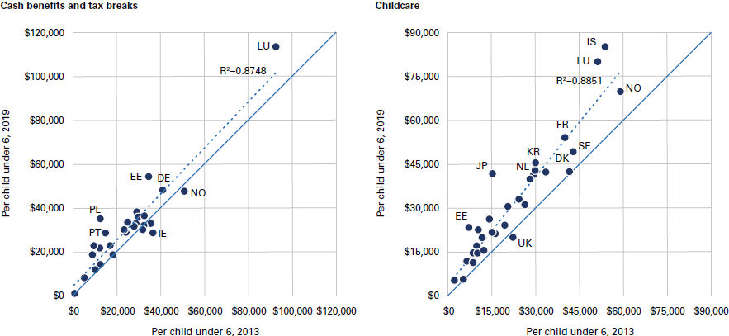
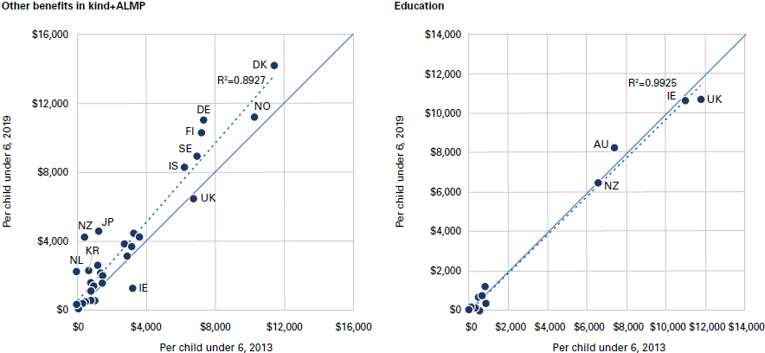
Trend changes in OECD spending on under-6’s pre-Covid
Source: OECD, 2023
Notes:
Children have been disproportionately impacted. 100 million additional children fall into poverty due to COVID, climate crises and conflict.
Urgency / enhanced relevance of leveraging public finance: Critical call to protect social spending, enhance its impact, while also identifying new financing mechanisms to address gaps and scale up innovation

Slide 19
Priority recommendations
Provide more for all of the youngest children, and families with the youngest children
Prioritize social protection policies that are inclusive of all children, beginning with UCBs as the foundational policy for children
Use foreign assistance, and other less-sustainable sources of finance, to catalyse efforts to strengthen welfare systems
Undertake incremental adjustment to the child policy portfolio
Utilize international goals and agreements in efforts to promote political will and consensus for change, particularly for the youngest children

