Slide 1
Expert Group Meeting in Celebration of the 30th anniversary of the International Year of the Family, 2024 (28-29 February 2024, The Everly Hotel, Kuala Lumpur)
Families and Megatrends: Interlinkages between migration, urbanization, new technologies, demographic trends and climate change
Emerging Trends in Domestic Migration Patterns in Japan
Rokuro Tabuchi
(Sophia University)

Slide 2
Objectives
Examines the recent trends in domestic (internal) migration within Japan
Analyzes how domestic migration patterns correlate with family formation among the younger cohort
Presents policy recommendations

Slide 3
Table of Contents
1. Population Decline and Aging in Japan
2. Recent internal migration trends in Japan
3. Trends in counterurbanization
4. Regional diversity of counterurbanization
Policy recommendations

Slide 4
1. Population Decline and Aging in Japan

Slide 5
Population decline in Japan
2015 Japan census marked the initial decrease in the total population since 1920, and this downward trend has persisted thereafter (Fig. 1)
Result of ongoing fertility decline since the 1970s
Total population is projected to dip below 100 million by 2060
The effects of population decline, including a decrease in the working population, are already causing tensions in Japanese society

Slide 7
Aging of the population
Percentage of the population aged 65 and over amounted to about 30% of the total population (2020 census)
Aging of the population has been exacerbated by the prolonged decline in birth rates (Fig. 2)
2023 population projections indicated that the population aged 65+ to make up about 40% by 2070
Aging and population decline are expected to further accelerate dur to the continued reduction in births stemming from the COVID-19

Slide 9
Exclusionary immigration policies
Number of foreign residents surged from approximately 1.3 in 2000 to over 2.7 million in 2020
Foreign population proportion remained around 2%, ranking among the lowest among OECD countries
Japanese government adheres to exclusionary measures toward immigrants
Government is hesitant to outline a broader vision for long-term admittance of migrant workers, casting a shadow over Japan’s economic and social prospects

Slide 10
2. Recent internal migration trends in Japan

Slide 11
Internal migration in Japan
Over the past seven decades, internal migration in Japan has undergone significant transformations
Japan's rapid industrialization and urbanization led to increased youth migration to metropolitan areas for work and education, resulting in the critical emergence of "depopulation" as a social issue
Migration to three major metropolitan areas sharply declined from the 1970s onwards, with Tokyo experiencing a noticeable trend of population concentration since the 1990s due to the concentration of economic opportunities (Fig. 3)

Slide 13
Recent trends in internal migration
Despite initial reports of increased out-migration from Tokyo area due to COVID-19, recent studies found a contradictory trend: there was no significant increase in migration from Tokyo to non-metropolitan areas
Despite the substantial changes in work and social dynamics prompted by COVID-19 in Japan, the trend towards greater population concentration in the Tokyo metropolitan area remains largely unchanged for now

Slide 14
3. Trends in counterurbanization

Slide 15
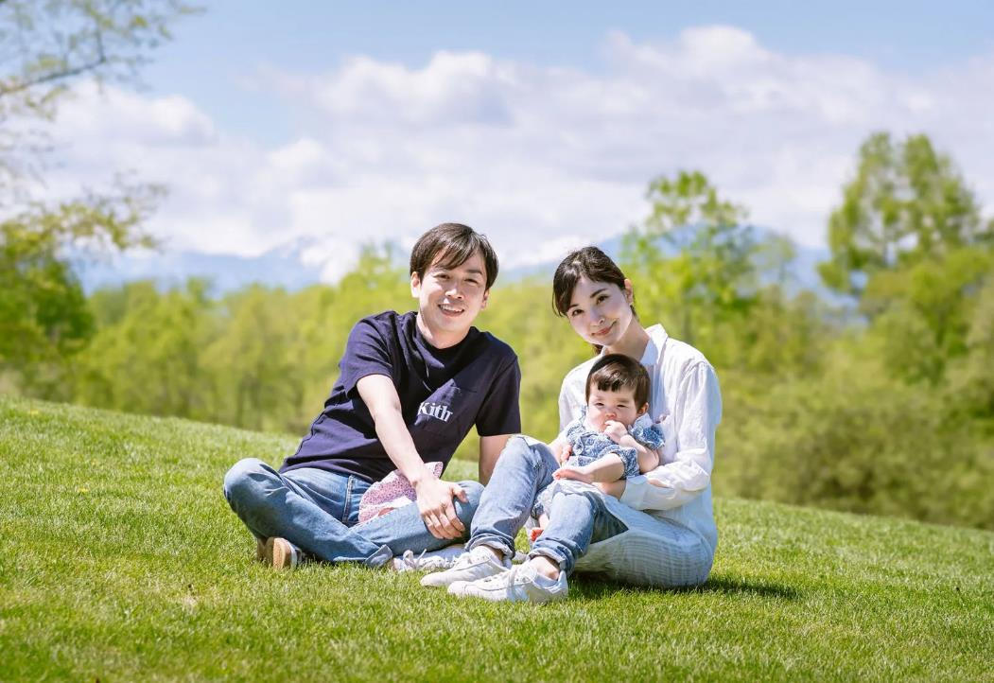
Lifestyle migration
Recent data in Japan reveals a distinct shift known as “counterurbanization,” involving migration from metropolitan to non-metropolitan areas
This paper adopts the framework of lifestyle migration, a subset of counterurbanization (Benson and O'Reilly 2009)
Lifestyle migration typically denotes relocation by relatively affluent individuals but is here employed more broadly to signify purposeful migration driven by the pursuit of an enhanced quality of life

Slide 16
Lifestyle migration (cont'd)
A notable trend of retirement migration has emerged, with analysis of population movements across prefectural boundaries showing individuals in their early 60s relocating to rural areas, as per Ishikawa (2016)
Whether COVID-19 has accelerated this trend remains to be analyzed in the forthcoming census

Slide 17
Lifestyle migration (cont'd)
Interest in migrating from metropolitan to rural areas is on the rise, demonstrated by an increasing number of migration consultations (Fig. 4)
A survey shows heightened interest post-COVID-19, particularly among individuals in their 20s (Fig. 5)
This shift may be influenced by the widespread adoption of remote work and the allure of rural living environments

Slide 19
Respondents in their 20s:6.1%, 14.0%, 24.8%

Slide 20
Lifestyle migration (cont'd)
Studies indicate that purposeful migration is prevalent among the younger generation in depopulated regions, including return migration to one's place of origin
A survey conducted in a western Japan town during the late 2000s revealed that while the older generation cited reasons aligned with traditional family values (caregiving to elderly parents etc.), the younger generation was motivated by practical considerations like proximity of workplaces accessible for commuting (Yamamoto, 2017)

Slide 21
Lifestyle migration (cont'd)
These findings highlight a notable trend in domestic migration, where individuals are moving to depopulated areas seeking improved living conditions and personal fulfillment
This trend may be linked to governmental initiatives like the Local Vitalization Cooperator (LVC) program, where individuals, mainly in their 30s and younger, relocate from urban to rural communities to revitalize the local area, often settling there
However, the concentration of employment and educational opportunities in metropolitan areas remains a significant obstacle to the widespread adoption of this lifestyle migration

Slide 22
4. Regional diversity of counterurbanization

Slide 23
Regional diversity of counterurbanization
Depopulated regions, particularly those distant from urban hubs with industrial concentrations and lacking higher education institutions, are less attractive for migration
Remote islands, isolated from the mainland by sea, face significant challenges for daily commuting
Analyzing population trends on these islands illustrates how local government initiatives impact lifestyle migration to depopulated areas

Slide 24
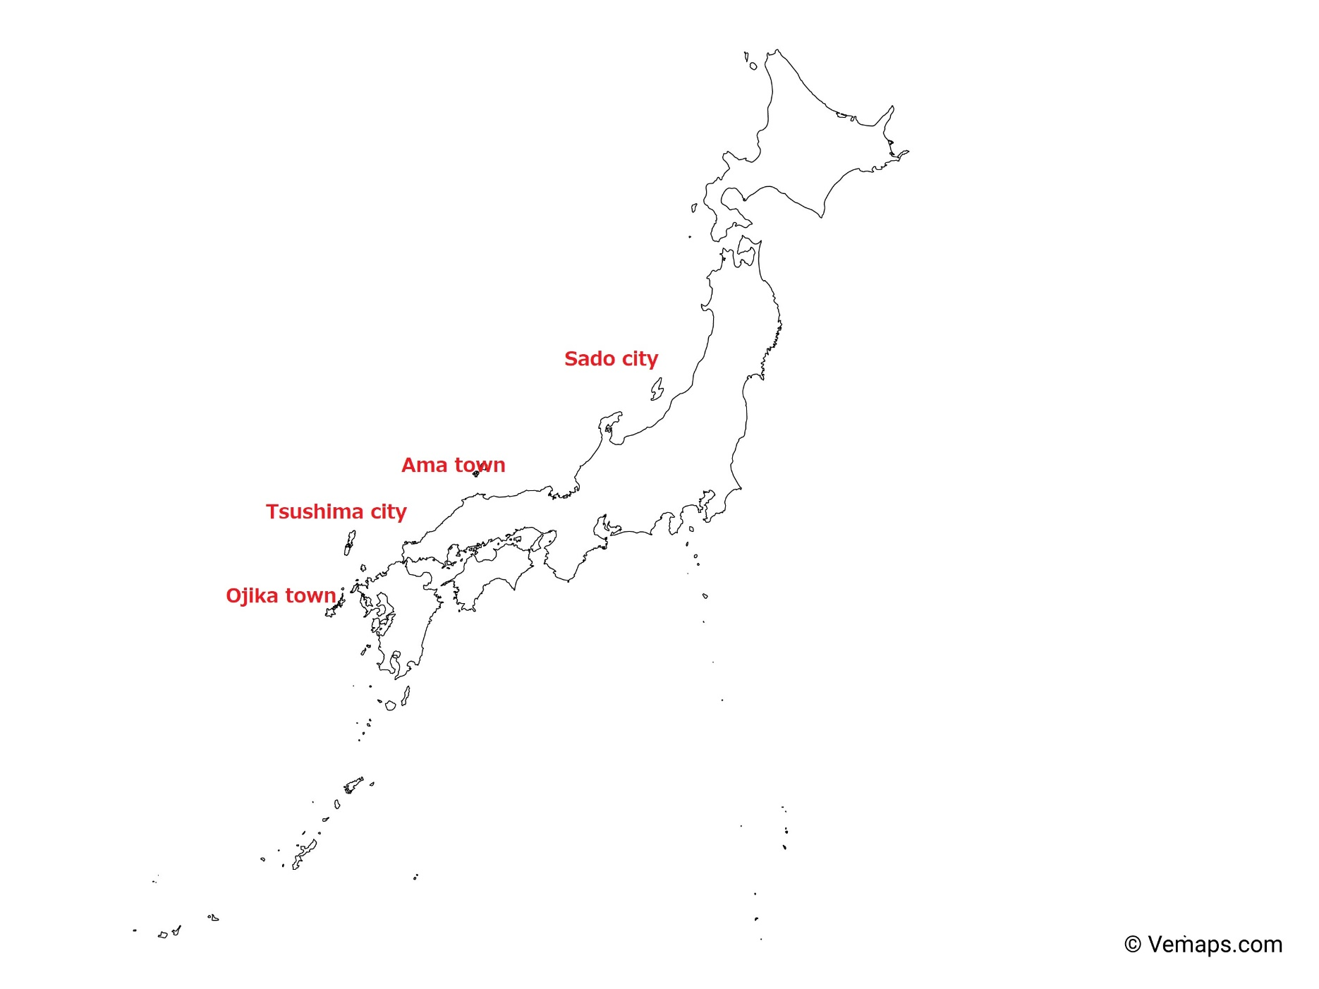
The four remote islands in Japan

Slide 25
The four remote islands in Japan
Table 1 Population and geographic condition of the four remote islands.
Remote island | Population (2020) | Geographic condition
Ama Town | 2267 | Very disadvantageous
Ojika Town | 2291 | Very disadvantageous
Tsushima City | 28502 | Very disadvantageous
Sado City | 51492 | Disadvantageous

Slide 26
The four remote islands in Japan
Table 2 Four demographic indicators of the four islands.
 | Population growth rate (2000-2020) | Percentage of young people settled (2020) *1 | 25-29 influx rate (2020) *2 | Percentage of never-married 30-34 (2020)
Ama town | -15% | 65% | 69% | 49%
Ojika town | -39% | 33% | 47% | 44%
Tsushima city | -31% | 46% | 46% | 37%
Sado city | -29% | 52% | 30% | 44%
Source: Japan Census (2000, 2020)
*1 Population aged 30-34 in 2020 divided by population aged 10-14 in 2000
*2 Percentage of the 25-29 year-old population in 2020 who lived in a different municipality 5 years earlier

Slide 27
Diversity among four remote islands
Ama, with the highest proportion of settled young people, demonstrates relative population stability
Sado, with the lowest influx of young migrants, indicates a higher propensity for youths to stay on the island
Ojika's low percentage of settled young people suggests a higher outflow than inflow of youths
Ama also records the highest rate of never-married youths, implying limited economic prospects affecting long-term settlement and family formation priorities

Slide 28
Remote Islands Study Abroad program
Remote Islands Study Abroad program is a recent education initiative implemented on remote islands since the early 21st century amidst declining populations
Currently operational in over 40 islands, elementary and junior high schools offer such programs.
These schools provide unique educational experiences, leveraging the island’s rich natural settings and community support, attracting families seeking such opportunities

Slide 29
Remote Islands Study Abroad program (cont'd)
In Sado city, two schools away from population centers offer study-abroad programs, with over half of participating students coming from outside the island
Conditions for joining require students to live in the adjacent area with their parents, often leading to family separation due to limited island employment opportunities
Some students face challenges in urban schools, prompting careful consideration by teachers
While the program can bolster educational infrastructure, it may involve family separations, particularly where stable employment is scarce, suggesting that expanding such programs may not drive lifestyle migration of families to remote islands

Slide 30
Policy recommendations

Slide 31
Internal Migration
Strengthen economic incentives to alleviate the excessive concentration of population in cities and to revitalize rural areas. This should include support for employment, entrepreneurship, and improved childcare services to facilitate work-life balance for individuals in rural areas.
Enhance incentives for venture companies and other businesses to establish operations in depopulated areas, particularly targeting the younger generations as potential employees.
Promote flexibilities in work arrangements, especially among the younger generation, by advocating for remote work options and creating conductive environments for working in rural areas.

Slide 32
Internal Migration (cont.d)
Implement flexible educational formats at public universities, allowing students to study while residing in underpopulated areas.
Improve the appeal of schools in underpopulated areas by increasing teacher staffing and developing engaging curricula.
Expand governmental programs such as the Local Vitalization Cooperator (LVC) initiative in depopulated areas to attract new residents, particularly the youth, and enhance economic support and public services to encourage settlement.

Slide 33
Urbanization / depopulation
Encourage investment and reform the tax system to enhance the attractiveness of local cities and depopulated areas, fostering economic opportunities.
Strengthen connections between urban and rural areas, facilitating mechanisms for urban residents to support rural communities through short-term stays and financial aid.

Slide 34
Family formation
Implement policies to support family formation among the younger generation, including enhanced childcare support and initiatives to balance work and family life.
Provide increased financial assistance to families relocating to rural areas, such as housing allowances, higher child allowances, and support for educational expenses.

Slide 35
Thank you
Correspondence: Rokuro Tabuchi, Sociology Dept.,
Sophia University. 1-7 Kioi-cho, Chiyoda-ku, Tokyo 1028554, Japan
E-mail: r-tabuch@sophia.ac.jp

