Slide 1
Transnational Migration , Gentrification, and Displacement: The Case of South Korea
Expert Group Meeting
Migration, Urbanization, Technology and Climate Change: Families and Megatrends
Kuala Lumpur, Malaysia
February 28-29, 2024
Ki-Soo Eun & Kyuwon Choi
Center for Transnational Migration and Social Inclusion
Graduate School of International Studies
Seoul National University

Slide 2
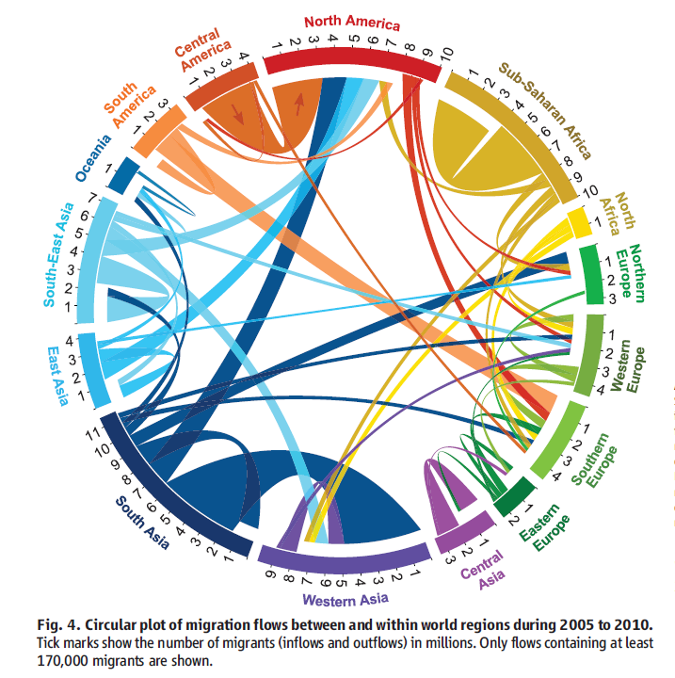
Quantifying International Migration
Source: Abel, Guy J. and Nikola Sander (28 March 2014). “Quantifying Global International Migration Flows” Science 343. 1520.

Slide 3
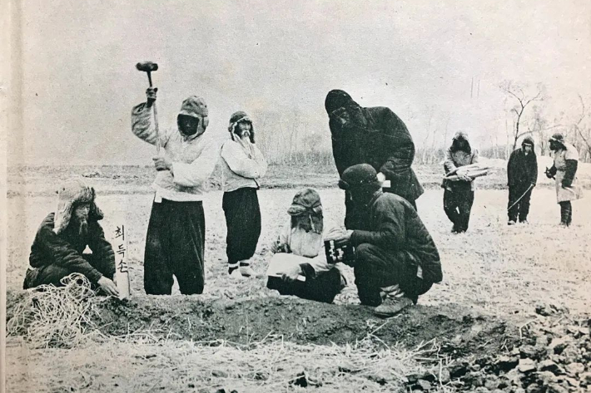
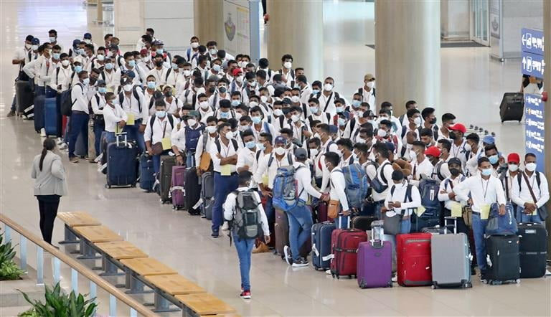
https://www.nocutnews.co.kr/news/5807822
https://www.hankyung.com/article/202307055849i
(Left) Migrant Korean ancestors working in Yanbian, China;
(Right) Foreign workers entering Korea with an Employment Permit System visa

Slide 4
Displacement of Koreans in History
Over 6.8 million Koreans settled across 170 countries since 1860. This history is divided into four distinct periods, with the first three highlighting displacement through migration (Yoon, 2012).
First Period: Early Migration (1860s - 1906)
Choson farmers and laborers migrated to China, Russia, and Hawaii due to political and economic hardship.

Slide 5
Displacement of Koreans in History
Over 6.8 million Koreans settled across 170 countries since 1860. This history is divided into four distinct periods, with the first three highlighting displacement through migration (Yoon, 2012).
Second Period: Japanese Colonial Era (1910 - 1945)
Displacement of landless farmers to Manchuria and Japan.
Political refugees and activists seeking asylum.
Manchurian Incident (1931) doubled Korean population in Manchuria.
Forced migration and drafting of Korean men for wartime labor and military service (Han 2002: 107).

Slide 6
Displacement of Koreans in History
Third Period: Post-War Migration Policy (1945 - 1962)
Establishment of South Korea’s first migration policy.
Students, war orphans, and interracial families move to North America.
6,000 Korean women married to US soldiers relocate to the US.
Around 5,000 children, including war orphans and adoptees, move to the US.
6,000 Korean students in the US, many settling permanently.
Groundwork for future immigration post-1965 US policy changes (Yu 1983: 234).

Slide 7
Modern Displacement of South Koreans - Gentrification
Capital reinvestment and commodification of space lead to displacement (Clark, 2005; Lees et al., 2008).
State-Led Urbanization in Seoul
Korean developmental state's role since the 1960s in shaping the urban landscape.
Urban redevelopment collaboration between real estate and property owners.
High-density construction driven by speculative market (Shin, 2009; Shin, 2011).

Slide 8
Modern Displacement of South Koreans - Gentrification
Socio-Economic Hardships and Socio-Political Dynamics of Displacement
Redevelopment improves physical conditions but imposes hardship through displacement.
Affordable housing demolition to make way for middle-class infrastructure (Porteous and Smith, 2001).
Struggle against forced eviction and housing rights (Kim et al., 1998; Shin, 2008).
However, in the current Seoul’s unique gentrification path, displacement issue not a major political concern(Shin and Kim, 2015; Davidson and Lees, 2010).

Slide 9
Modern Displacement of non-Koreans in South Korea through Gentrification
Korea's Demographic Shift
From a homogeneous society to a multicultural one.
The rise in foreign residents and multinational marriages.
Transformation into a Labor-Importing Nation

Slide 10
Modern Displacement of non-Koreans in South Korea - Gentrification
Emergence of Residential Enclaves
Development of distinct ethnic communities within urban settings.
Introduction of cultural diversity in a historically uniform society.
Case of Africa business enclave in Itaewon, Seoul, South Korea shows displacement through gentrification

Slide 11
Modern Displacement of non-Koreans in South Korea - Gentrification

Slide 12
Transnational Migration - From Africa to South Korea
Since the late 1980s, increase in migration especially from countries in sub-Saharan Africa.
- Acceleration and diversification of emigration out of Africa, driven by economic opportunities and social transformation.
The number of African migrants in South Korea is steadily growing.
Number of Africans in South Korea
2013 10,880
2022 19,258

Slide 13
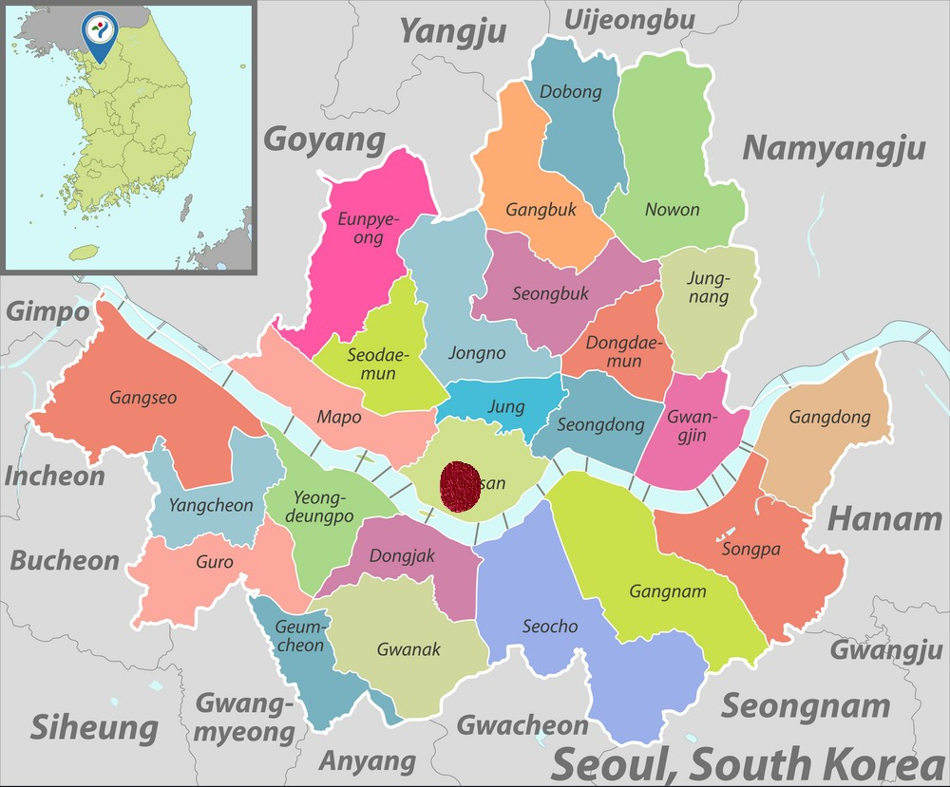
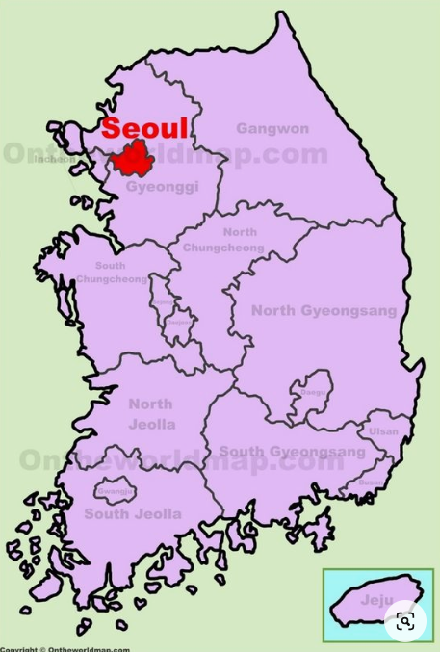
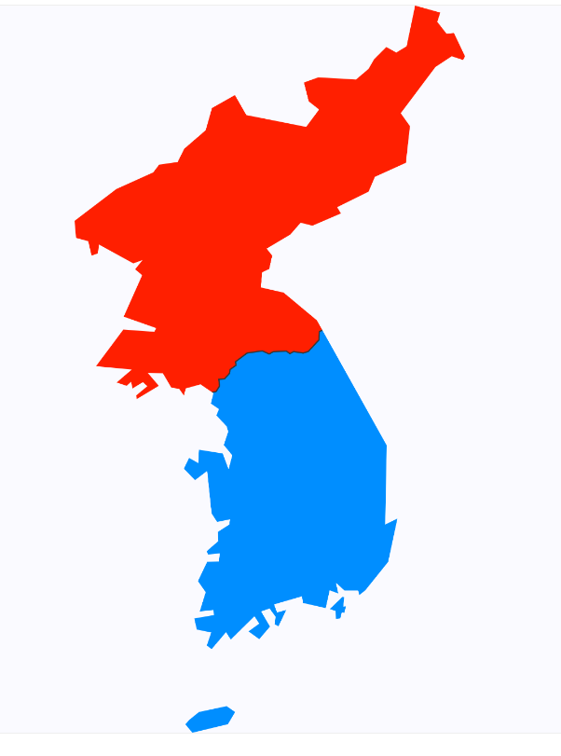
Seoul; Itaewon
Itaewon

Slide 14
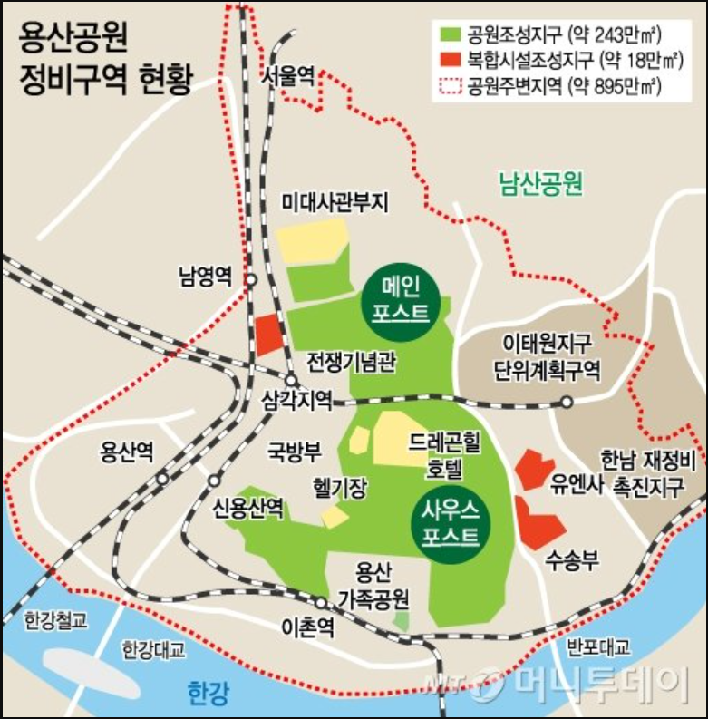
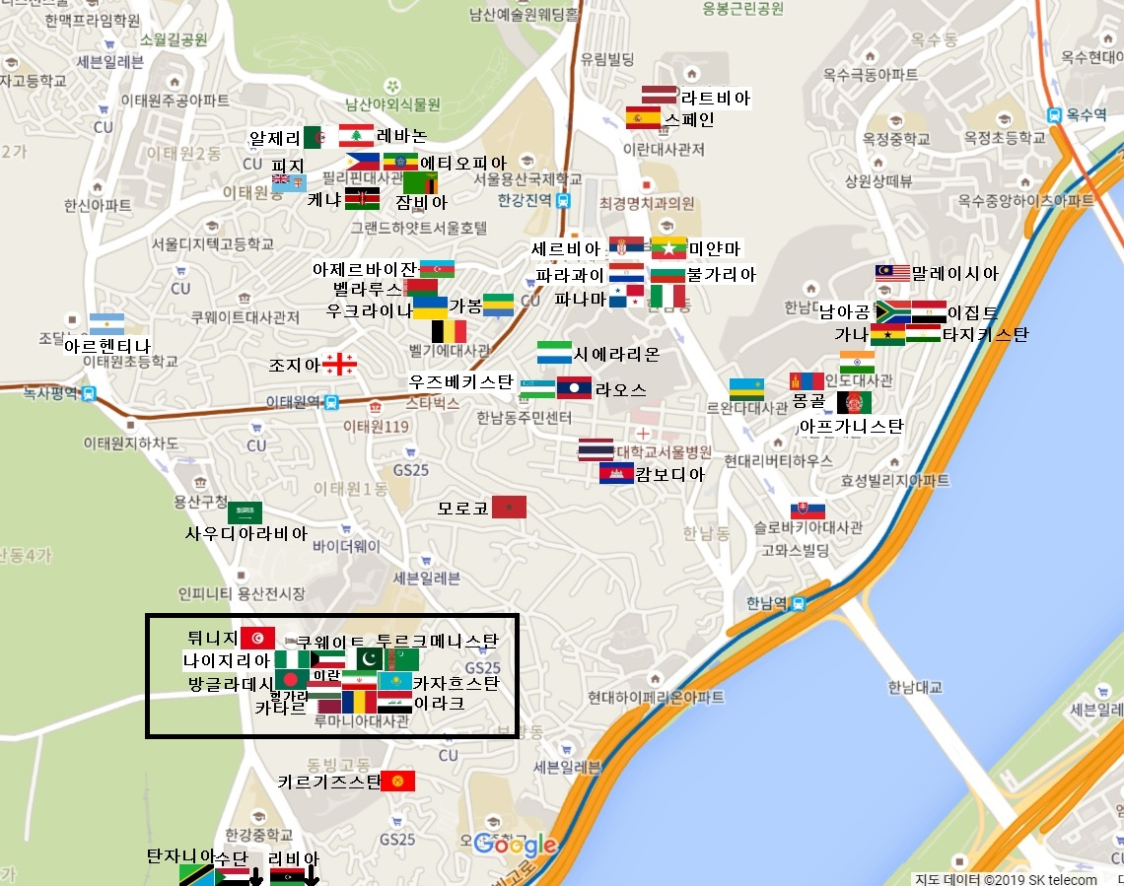
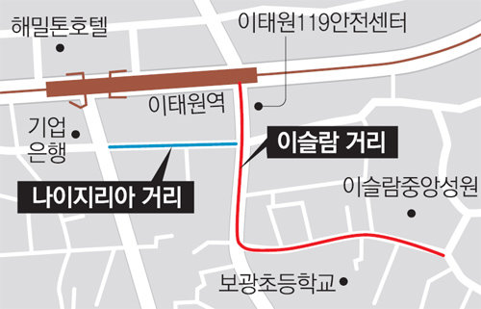
Africa business enclave in Itaewon
Itaewon, Seoul’s Multi-ethnic Enclave
With the US military base, embassies, and Seoul Central Mosque, Itaewon hosts residential and commercial functions for foreigners in Seoul.
Islam Street
Nigerian Street
Central Mosque
https://news.mt.co.kr/mtview.php?no=2015092510264925619&type=1&VR
https://troubadour.tistory.com/60
https://www.donga.com/news/Society/article/all/20140604/63993597/1

Slide 15
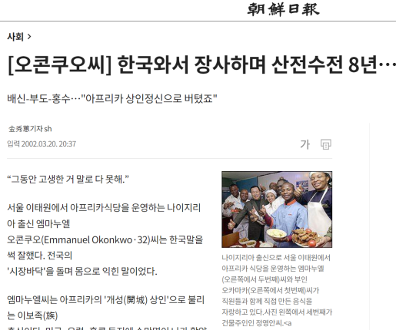
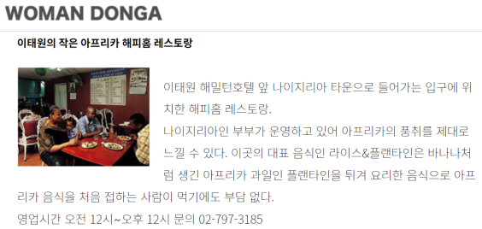
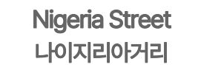
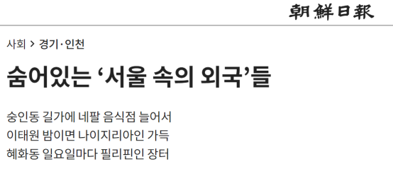
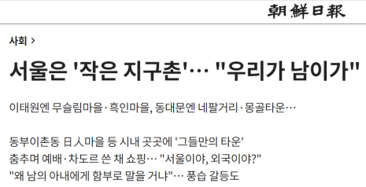
Africa business enclave in Itaewon reported in Korean Daily Newspapers

Slide 16
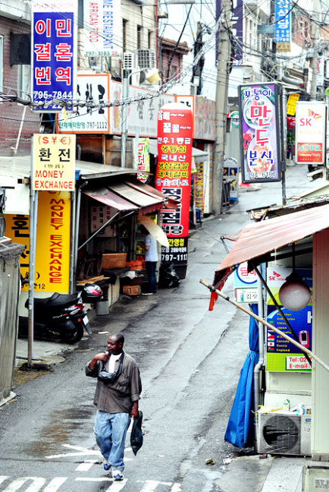
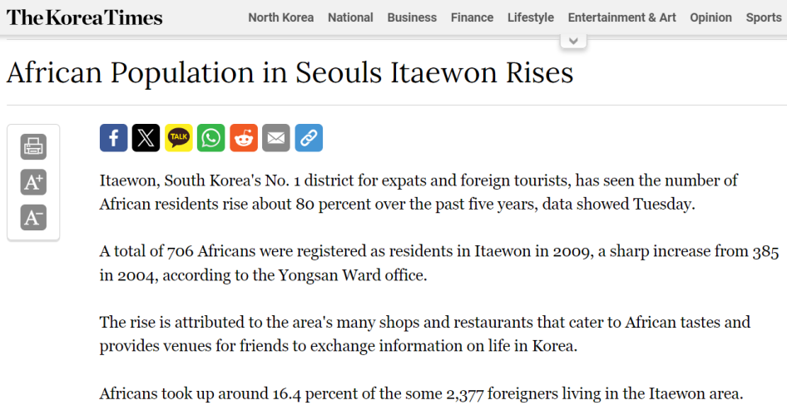
Africa business enclave in Itaewon

Slide 17
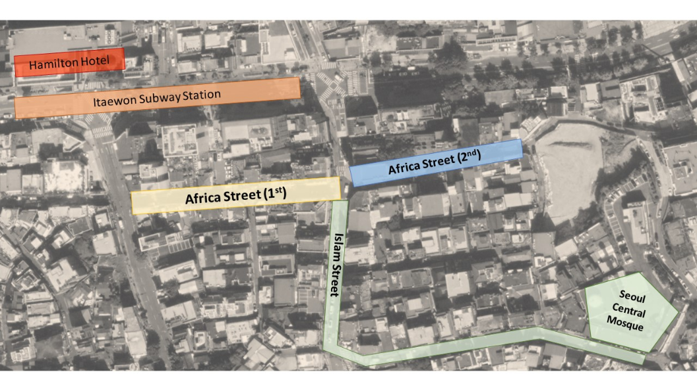
Africa business enclave in Itaewon
1. Emerged in the 2000s
2. Low rent in the old Ihwa Market street and Hookerhill
3. Dissolution of Africa Street started in 2012 due to gentrification.
[Map] of African Street in Itaewon
- 1st African Street: Old Ihwa Market Street
- 2nd African Street: Hookerhill

Slide 18
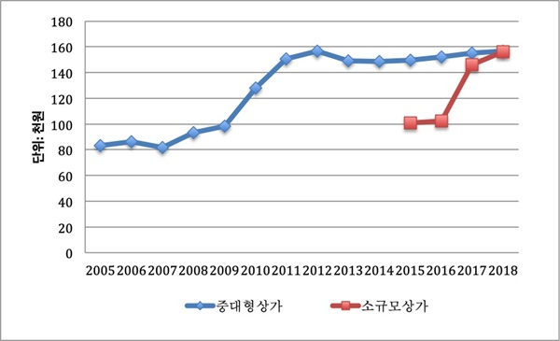
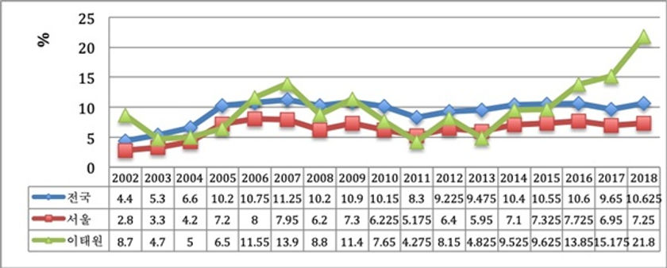
Africa business enclave in Itaewon
Unit: Thousand Won
Nation
Seoul
Medium and Large
Shopping Center
Small
Shopping Center
Itaewon
Fig. 1. Change in rent in Itaewon by year
and size: 2005-2018
Fig. 2. Vacancy rate change by year for medium-to-large shopping malls in Itaewon: 2002-2018
*Green Triangle is for Itaewon.

Slide 19
2009 Establishment of 8 African businesses: 3 restaurants, 4 hair salons, 1 ethnic market.
2023 One African restaurant and club is open for business on the once Africa Street.

Slide 20
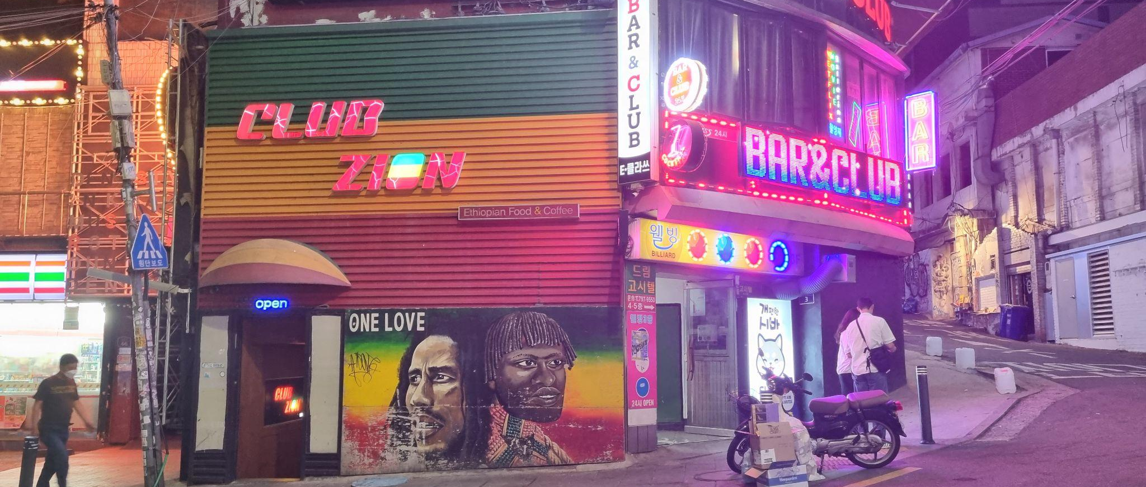
Club Zion known for its mural with Bob Marley and an ethnic african native, located at the edge of the once African Street, open on a Tuesday night - May 2023

Slide 21
Africa business enclave in Itaewon
The displacement of African migrants at Itaewaon was due to state-led gentrification via the development of Hannam-dong New Town in 2004, an urban development project led by the government (Choi, 2024).
Indirect, direct, and symbolic displacement impacts on the
ethnic enclave.

Slide 22
Understanding Displacement in Gentrification
Gentrification transforms urban spaces, often resulting in the displacement of existing users and owners by more affluent groups, categorized into direct, indirect, and symbolic forms (Shin et al. 2016; Janoschka et al. 2014).
Direct Displacement
Direct displacement involves the immediate expulsion of residents due to physical actions or economic pressures, such as eviction or unaffordable rent increases (Shin et al. 2016).
Indirect Displacement
Indirect displacement occurs gradually, through increased living costs and property values in surrounding areas, making neighborhoods inaccessible to original residents (Marcuse, 1985; Davidson and Lees 2010; Lees et al. 2008).
Symbolic Displacement
Symbolic displacement refers to the erosion of the cultural identity and sense of community among long-term residents, leading to feelings of alienation (Atkinson, 2015).

Slide 23
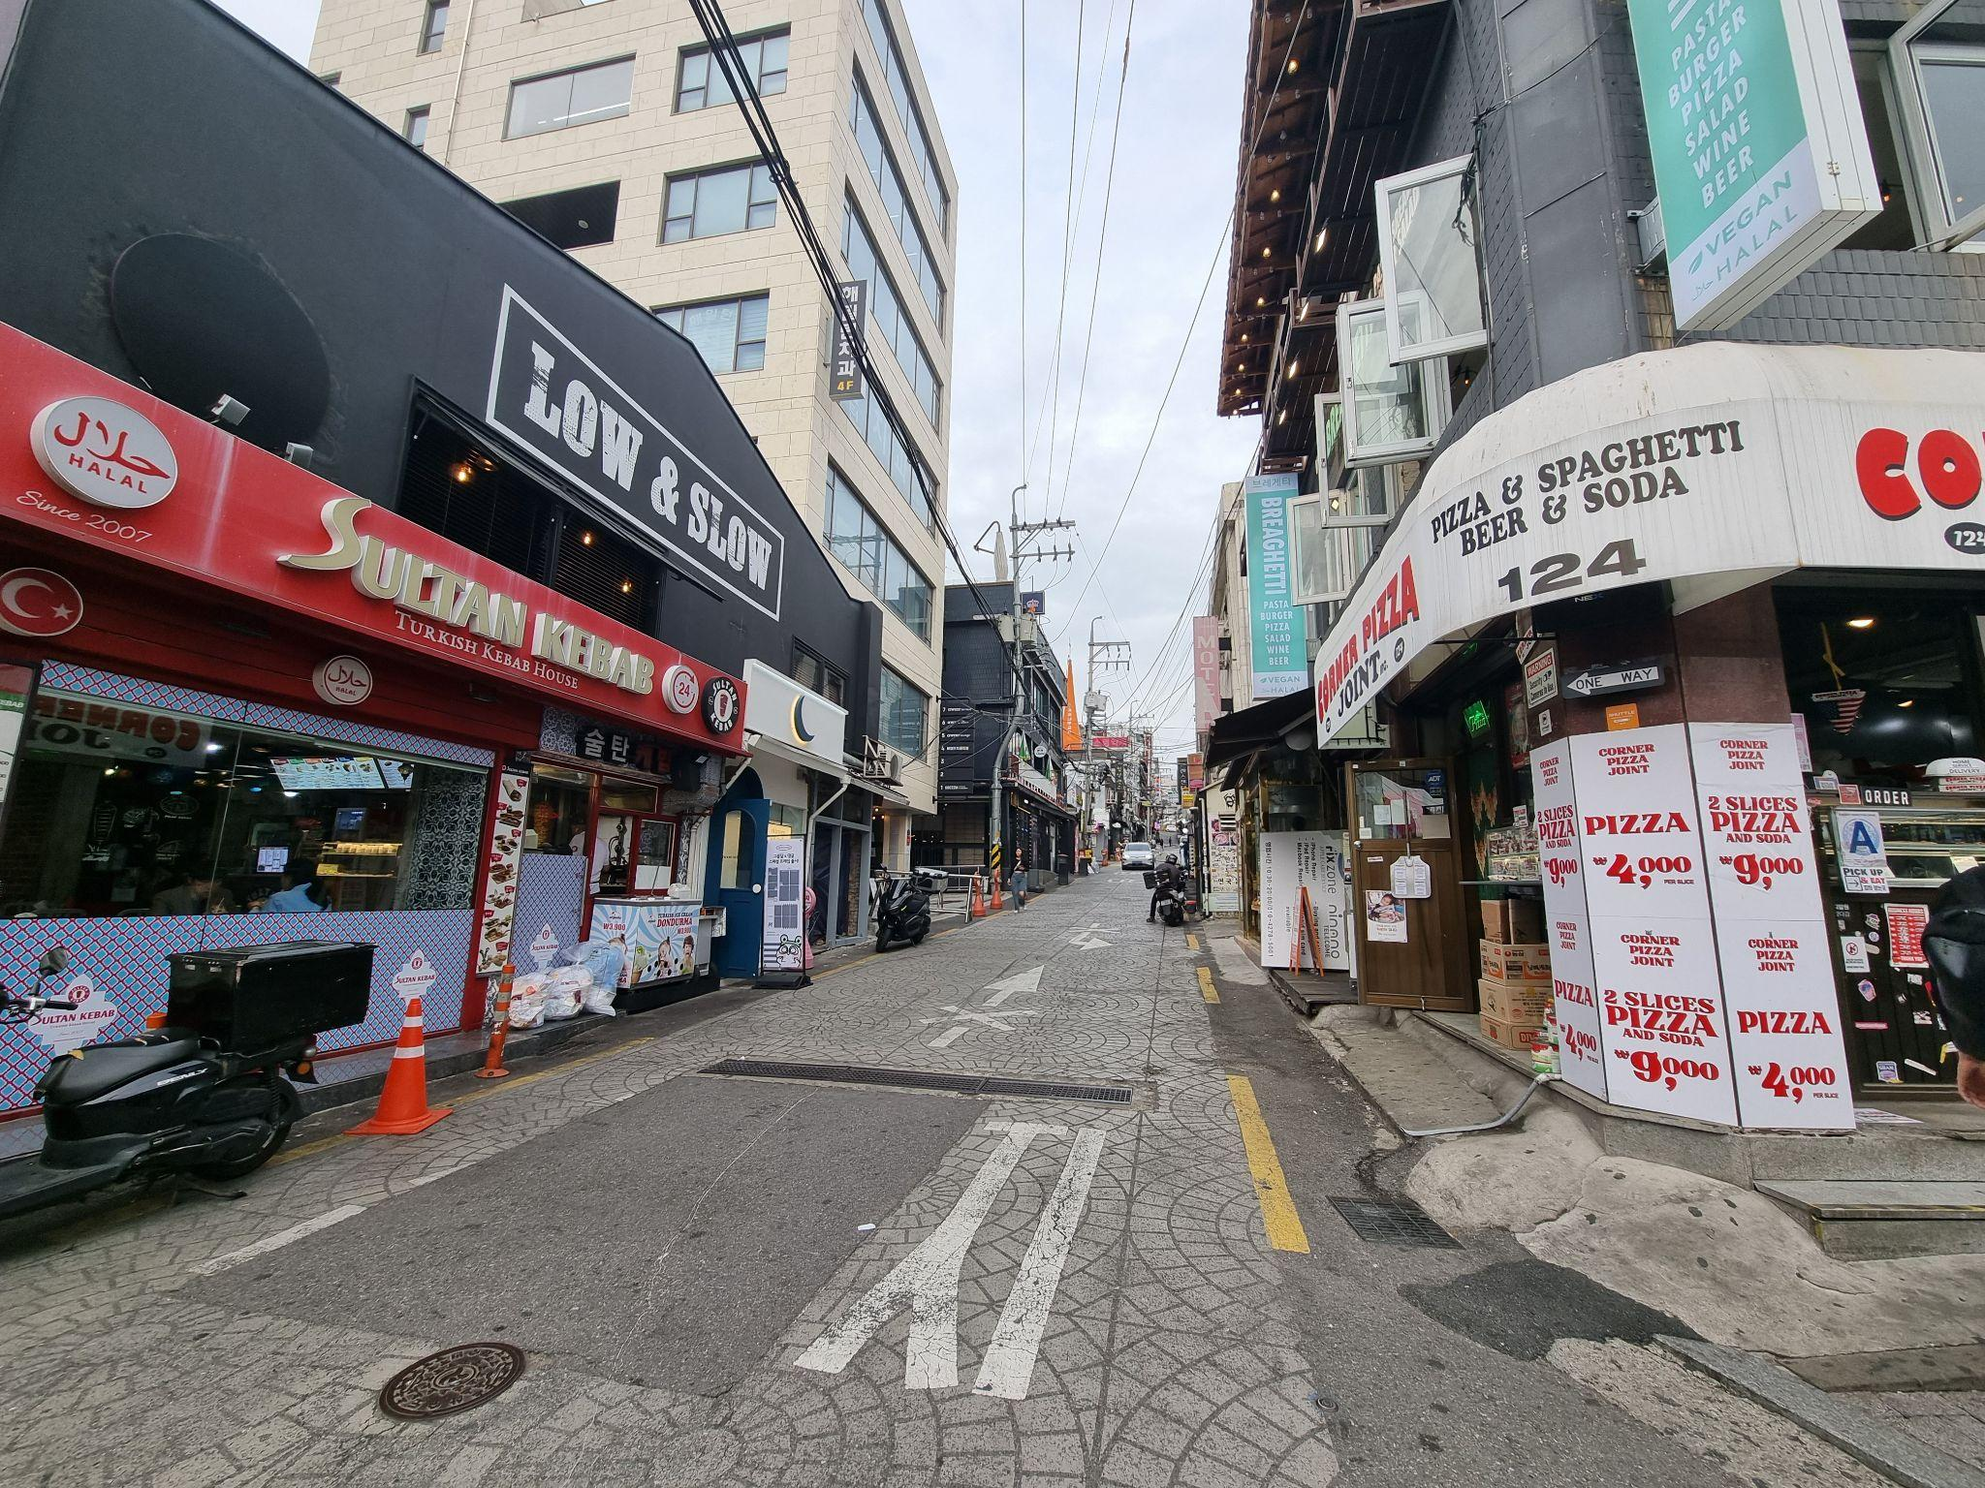
Before Displacement of Africa Street
After Displacement of Africa Street

Slide 24
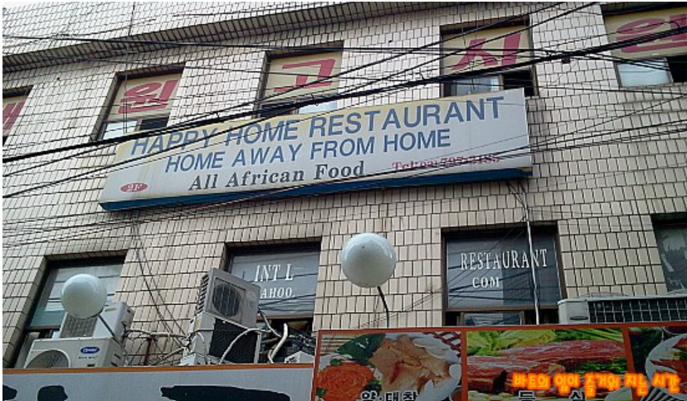
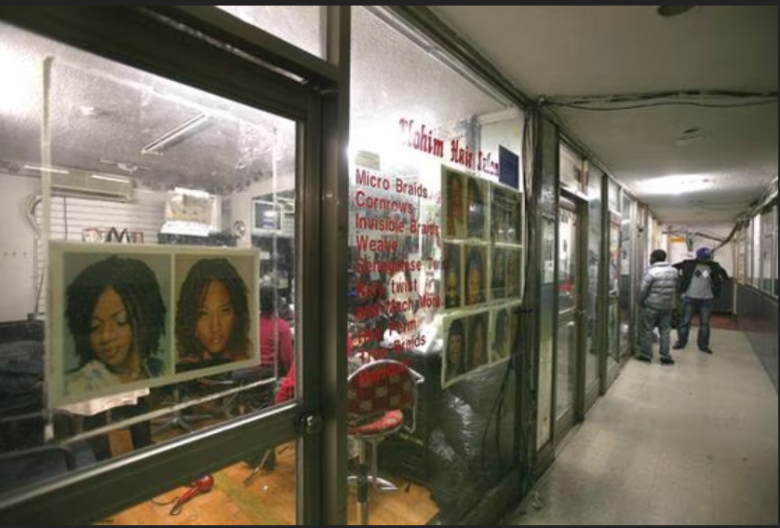
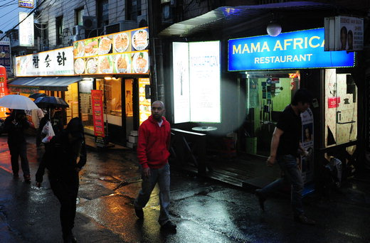
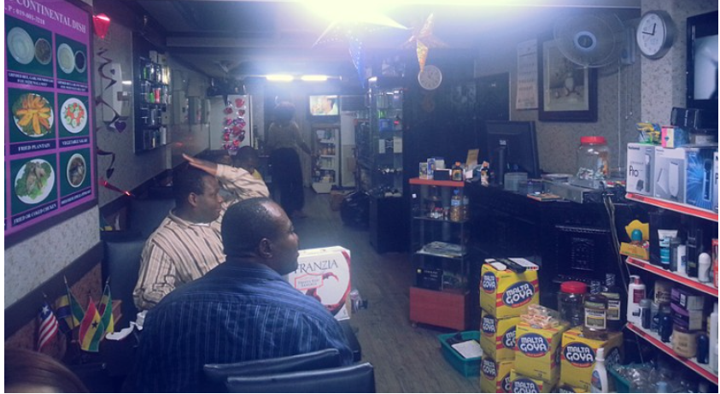
Before Displacement of Africa Street

Slide 25
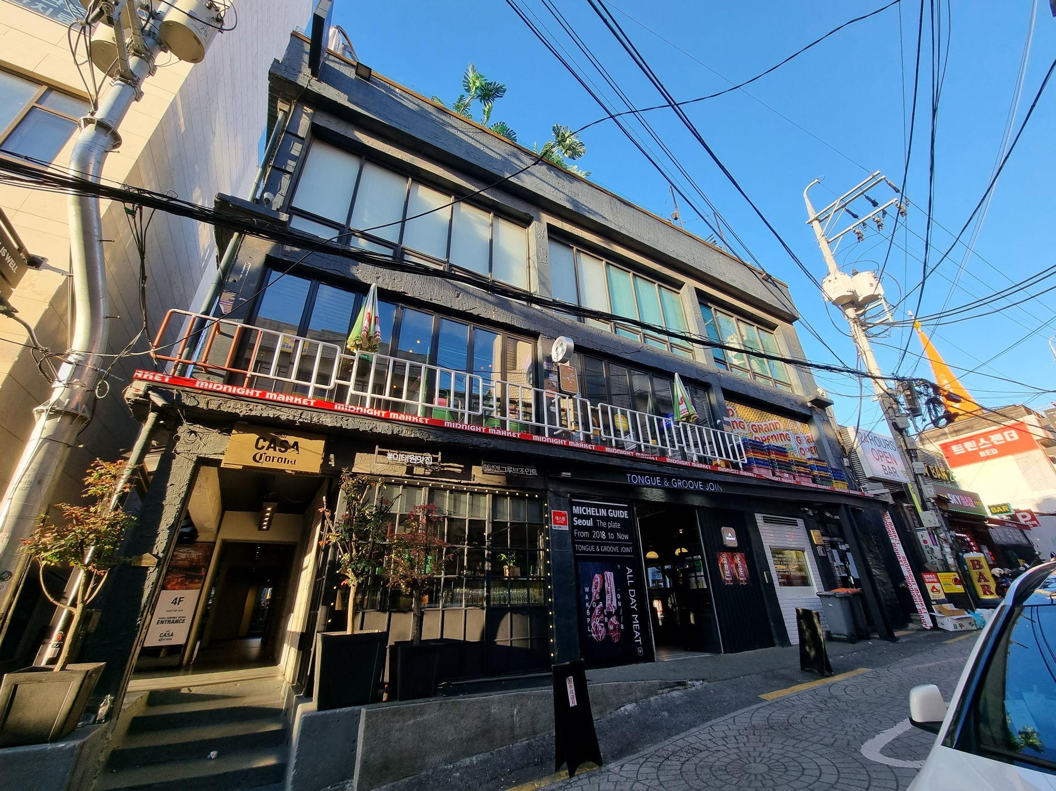
After Displacement of Africa Street

Slide 26
Conclusion
■ Introduction to South Korea's Demographic Shift
Historically homogeneous, South Korea is now experiencing significant transnational migration.
■ Inflow of African Migrants
African migrants are becoming increasingly prominent in South Korea.
Many choose to work and live in urban areas, notably due to the absence of work permit visa requirements.

Slide 27
Conclusion
■ Development of an African Enclave
An African enclave has developed in the Itaewon area.
A business enclave known as 'Africa Street' has emerged, serving as a cultural and commercial hub.
■ Impact of Gentrification
Gentrification and state-led urban development have led to the fading of Africa Street.
African migrants face displacement due to these gentrification efforts.

Slide 28
Conclusion
■ Dual Displacement Challenges
African migrants in South Korea encounter dual challenges: displacement from their countries of origin and from their places of settlement due to gentrification.
This reflects broader themes of socio-economic dynamics of transnational migration, displacement, and gentrification.

Slide 29
Reference
Atkinson, R. (2015). Losing one’s place: Narratives of neighborhood change, market injustice, and symbolic displacement. Housing, Theory and Society, 32(4), 373-388.
Clark, E. (2005). The order and simplicity of gentrification: A political challenge. In R. Atkinson & G. Bridge (Eds.), Gentrification in a Global Context: The New Urban Colonialism (pp. 256-264). London: Routledge.
Davidson, M., & Lees, L. (2010). New-build gentrification: Its histories, trajectories, and critical geographies. Population, Space and Place, 16(5), 395–411.
Han, K.K. (2002). The history and current situation of the Korean diaspora and migration: Japan. In I.Y. Yim (Ed.), New Concepts and Approaches to National Integration (Part II): National Integration in the Period of Globalization and Information (pp. 91-149). Chunchon: Hallym University Research Institute of National Integration.
Janoschka, M., Sequera, J., & Salinas, L. (2014). Gentrification in Spain and Latin America – A critical dialogue. International Journal of Urban and Regional Research, 38(4), 1234-1265.
Kim, S.-H., Jeon, H.-G., Jang, J.-H., et al. (1998). Eviction from the Perspective of Evictees. Seoul: Korea Centre for City and Environment Research. (In Korean)
Lees, L., Slater, T., & Wyly, E. (2008). Gentrification. New York: Routledge.
Marcuse, P. (1985). Gentrification, abandonment, and displacement: Connections, causes, and policy responses in New York City. Journal of Urban and Contemporary Law, 28, 195–240.

Slide 30
Reference
Porteous, J.D., & Smith, S.E. (2001). Domicide: The Global Destruction of Home. Montreal: McGill-Queen’s University Press.
Shin, H.B. (2008). Living on the edge: Financing post-displacement housing in urban redevelopment projects in Seoul. Environment and Urbanization, 20(2), 411–426.
Shin, H.B. (2009). Property-based redevelopment and gentrification: The case of Seoul, South Korea. Geoforum, 40(5), 906–917.
Shin, H.B. (2011). Vertical accumulation and accelerated urbanism: The East Asian experience. In M. Gandy (Ed.), Urban Constellations (pp. 48–53). Berlin: Jovis.
Shin, H.B., & Kim, S.-H. (2016). The developmental state, speculative urbanisation and the politics of displacement in gentrifying Seoul. Urban Studies, 53(3), 540-559.
Shin, H.B., Lees, L., & López-Morales, E. (2016). Introduction: Locating gentrification in the Global East. Urban Studies, 53(3), 455–470.
Yoon, I.J. (2012). Migration and the Korean diaspora: A comparative description of five cases. Journal of Ethnic and Migration Studies, 38(3), 413-435.
Yu, E.Y. (1983). Korean communities in America: Past, present, and future. Amerasia Journal, 10(2), 1-51.

